Slide 1
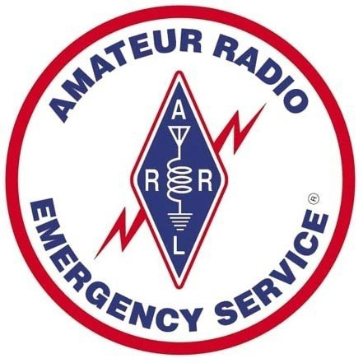
Gulf Coast
MS ARES
3 May 2025
ARES SEC Meeting
KC5IMN, Robert Hayes SEC MS Section ARES KC5IMN@Arrl.net

Slide 2

Topics covered:
Simulated Emergency Test: Describe and an overview of successes
What is ARES
Training requirements, how to sign up
Qualifications for membership (when you need an ARRL membership to be a Sr. Leader)
How ARES works in MS, W5XX, KC5IMN, DEC’s, EC’s AEC’s
ARRL required monthly reporting: How MS ARES does it
Google Survey, Form 2, and Form 4
ICS-205 for MS ARES
Digital Radio for ARES
The use of linked networks and Hot-Spots to support wide-area storm reporting/spotting
Storm Spotting for MS- We need coordination and updating of processes

Slide 3
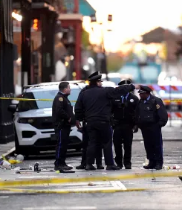
SET: What is it?
The main purpose of the SET is to evaluate strengths and weaknesses in Amateur Radio emergency preparedness as well as to demonstrate amateur radio to our served agencies and the general public.
We plan to use the following bands and modes from the field, in the mobile, at EOC's and at other served agency locations:
•HF, VHF, UHF
•Analog Voice, SSB,
•Digital voice and data,
•Packet and APRS for good measure.

Slide 4
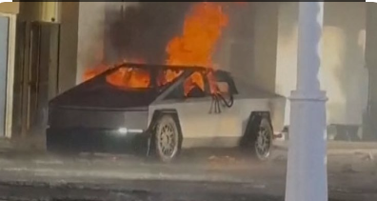
What is being simulated?
This SET will simulate a a scripted scenario that revolves around responses to local terror attacks to the homeland.
  Not only will we be looking to exceed our scores from last year's SET, but we will be make ourselves very visible to our public in the best manner possible.
There will be coordination meetings and phone calls going on all month.
Each County EC will come up with his/her own county’s scenario specifics based on the above SET Scenario Script.
Each County ARES Team, in planning their specific scenario, should leverage the script and then tailor their simulated ARES response to the effects which would be most likely to occur in their county if a real communications disruption occurred.

Slide 5
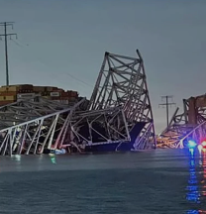
Protecting the Homeland
Scenario Overview:
At 08:00 AM, Saturday 9 August, multiple explosions and armed attacks will occur simultaneously along major interstate highways and critical infrastructure points.
Reports indicate that coordinated terrorist cells, composed of radicalized immigrant groups, have executed the attacks using explosives, vehicle ramming, and small-arms fire.
Several key highway junctions and bridges have been severely damaged, causing mass casualties and severe traffic disruptions.
  ARES members will be asked to activate of emergency operations centers (EOCs).
  Ensure continuous situational awareness using amateur radio networks.
  Provide clear, timely, and accurate information to served agencies

Slide 6
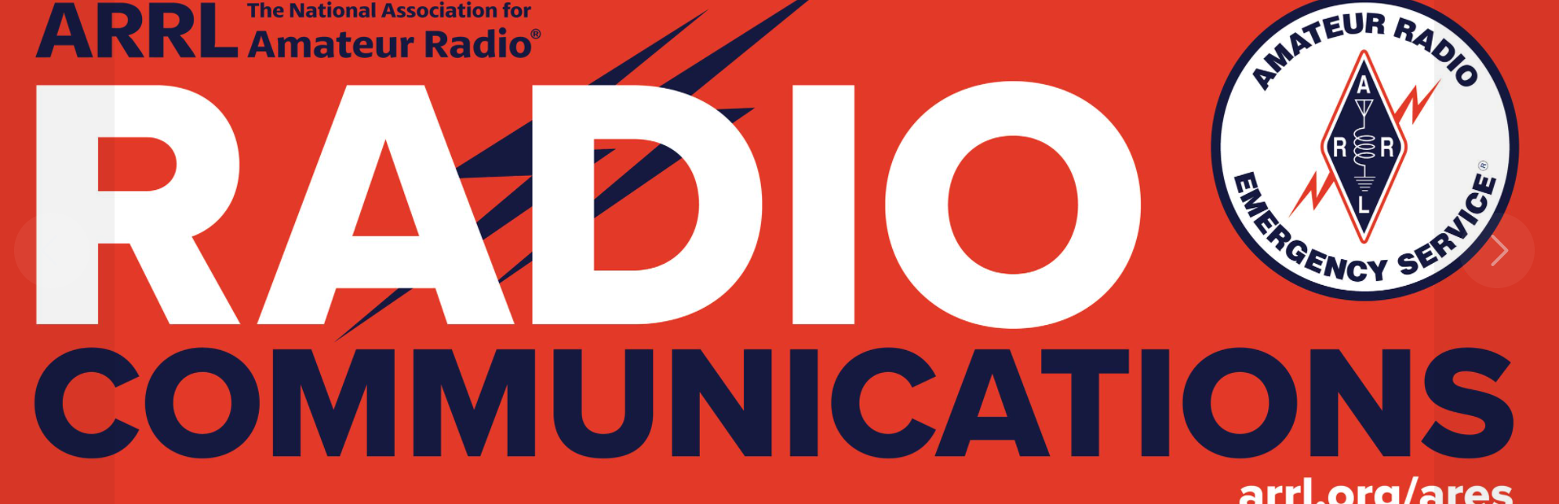
What is ARES
Amateur Radio Emergency Service® (ARES) The Amateur Radio Emergency Service® (ARES) consists of licensed amateurs who have voluntarily registered their qualifications and equipment, with their local ARES leadership, for communications duty in the public service when disaster strikes.
ARES Membership Requirements: Every licensed amateur, regardless of membership in ARRL or any other local or national organization is eligible to apply for membership in ARES. Training may be required or desired to participate fully in ARES. Because ARES is an Amateur Radio program, only licensed radio amateurs are eligible for membership. The possession of emergency-powered equipment is desirable, but is not a requirement for membership.

Slide 7
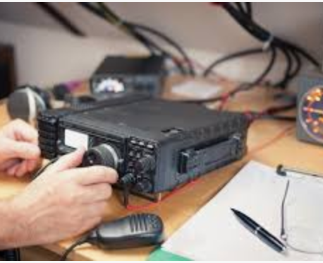
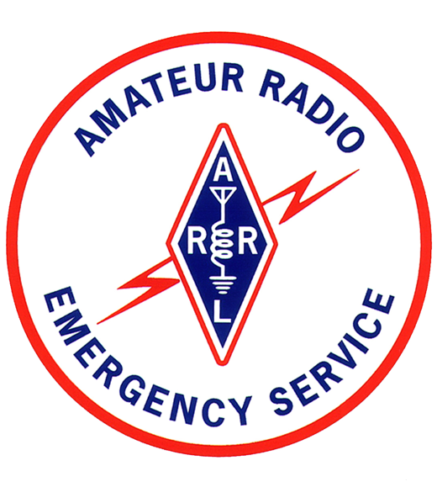
The MS ARES Mission Statement
It is the mission of the Mississippi Section Amateur Radio Emergency Service (ARES) to serve as the coordinating point for Amateur radio operators and their served agencies in the event of a communications emergency.
ARES is a national level volunteer organization whose purpose is to serve the public by providing licensed, certified, and competent Amateur Radio communications to federal, state, county, and local government agencies, as well as to nonprofit disaster relief organizations.

Slide 8
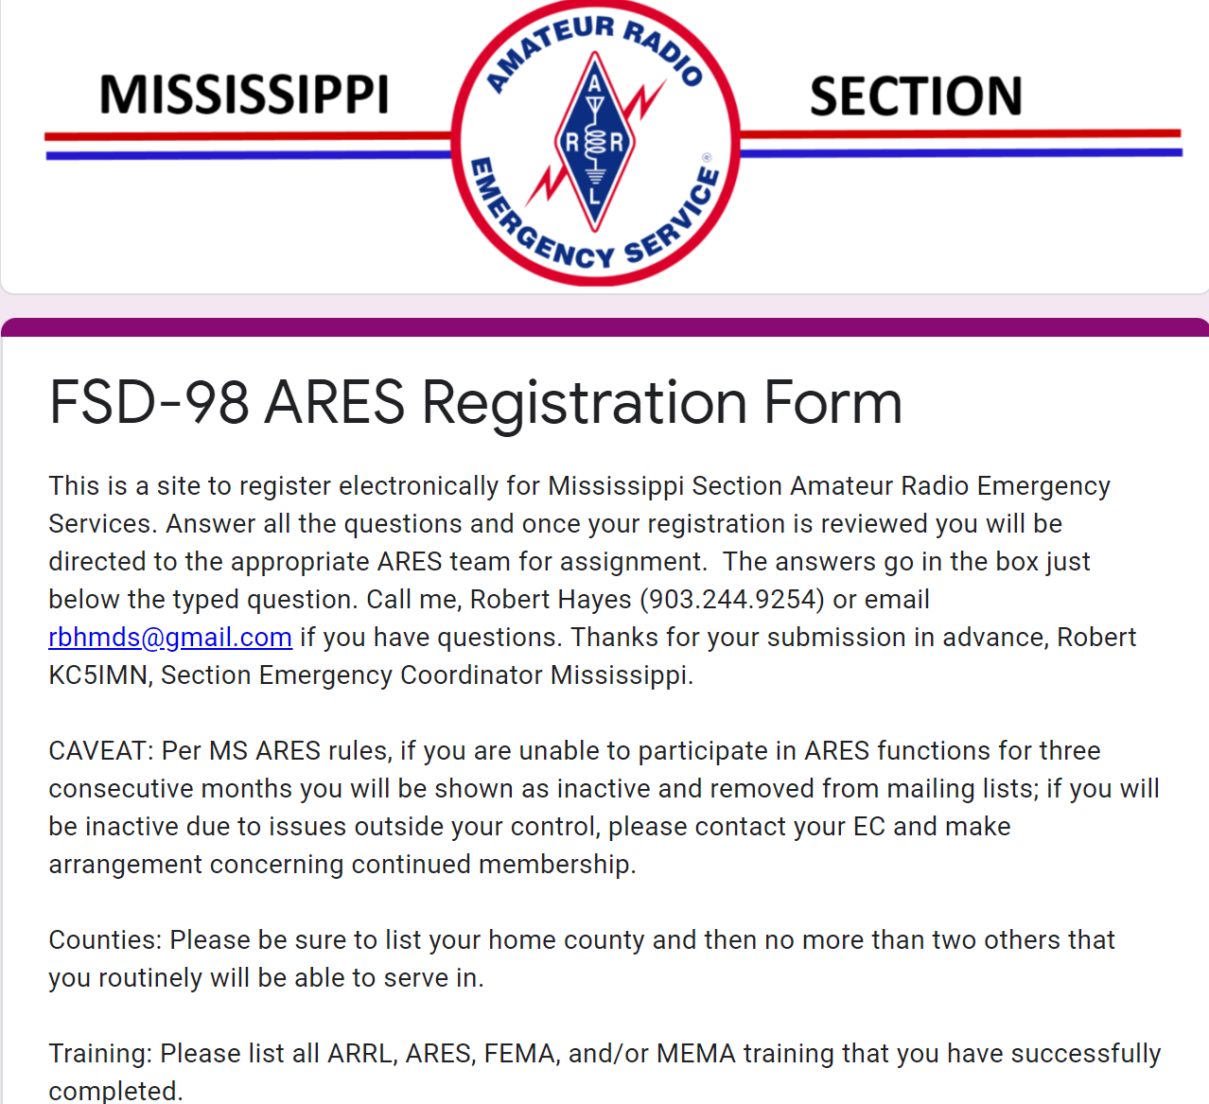
How To Become a Member of ARES
Notify Robert Hayes , KC5IMN@ARRL.net and get a link to the Online Sign-up Portal.

Slide 9
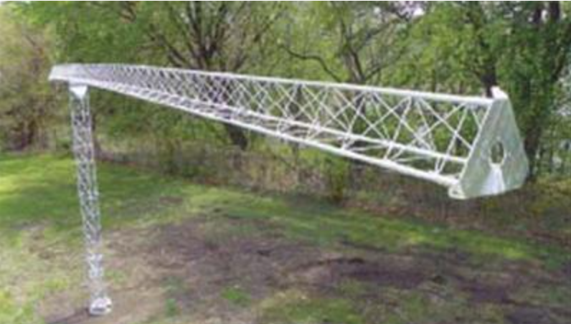
How ARES Works in Mississippi
Mississippi Section Emergency Organization – Roles Overview
Section Manager (SM) – Elected leader responsible for ensuring Mississippi Amateurs are prepared for emergencies. Appoints the Section Emergency Coordinator (SEC) and coordinates with other SMs during regional emergencies.
Section Emergency Coordinator (SEC) – Appointed by the SM to oversee statewide Amateur Radio emergency operations, maintain contact with emergency management agencies, recruit and appoint District Emergency Coordinators (DECs), and lead section-level response efforts.
District Emergency Coordinator (DEC) – Appointed by the SEC to manage emergency operations within a designated district. Ensures each county has a Emergency Coordinator (EC) and assists in local emergency planning and response.
Emergency Coordinator (EC) – Appointed by the DEC to lead emergency communications in a county or group of counties. Works with local agencies, recruits members, manages repeater use, and conducts emergency exercises.
Assistant Emergency Coordinator (AEC) – Selected by the EC to assist in various operational areas, including administration, logistics, and liaison duties. This is a local role without ARRL approval requirements.
Official Emergency Station (OES) – Appointed by the SM upon recommendation, an OES is an experienced and well-equipped operator ready to provide emergency communications via HF and/or VHF using emergency power.

Slide 10
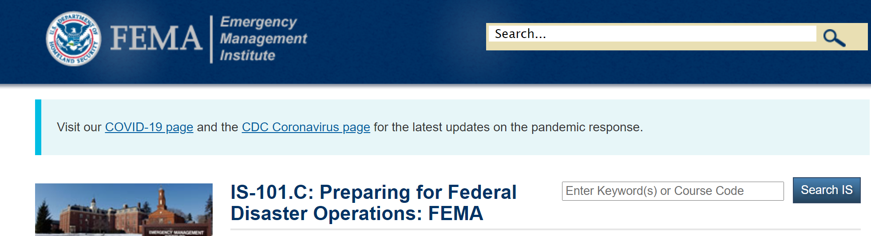
Supported Events by ARES Teams Mississippi
Runs
Rides
Races
Storm Spotting
Public Service Ops
Emcomm Support (Fires and such)
Parades
Wide area event coordination (but we don’t get paid)
Civil Emergencies

Slide 11
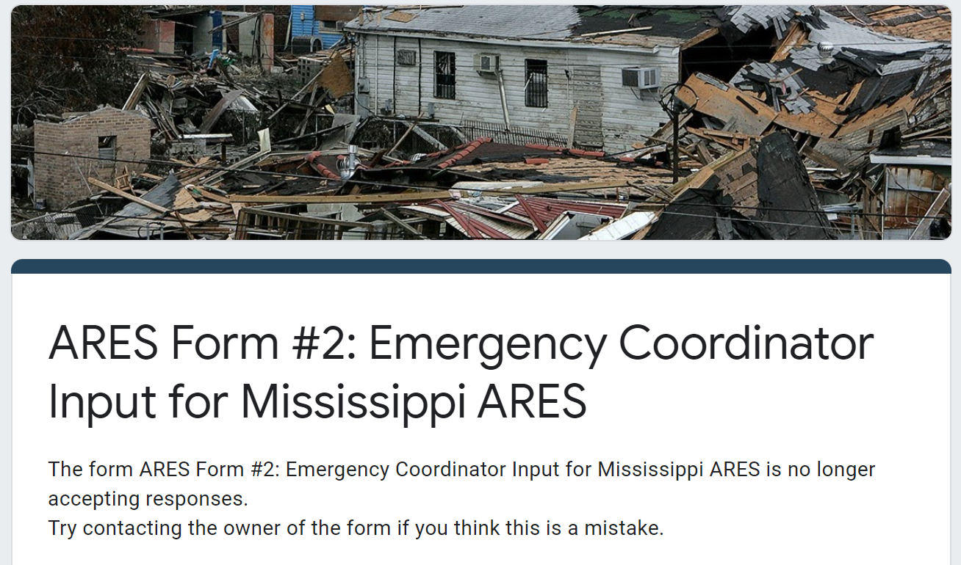
Required Monthly Reporting for EC’s

Slide 12
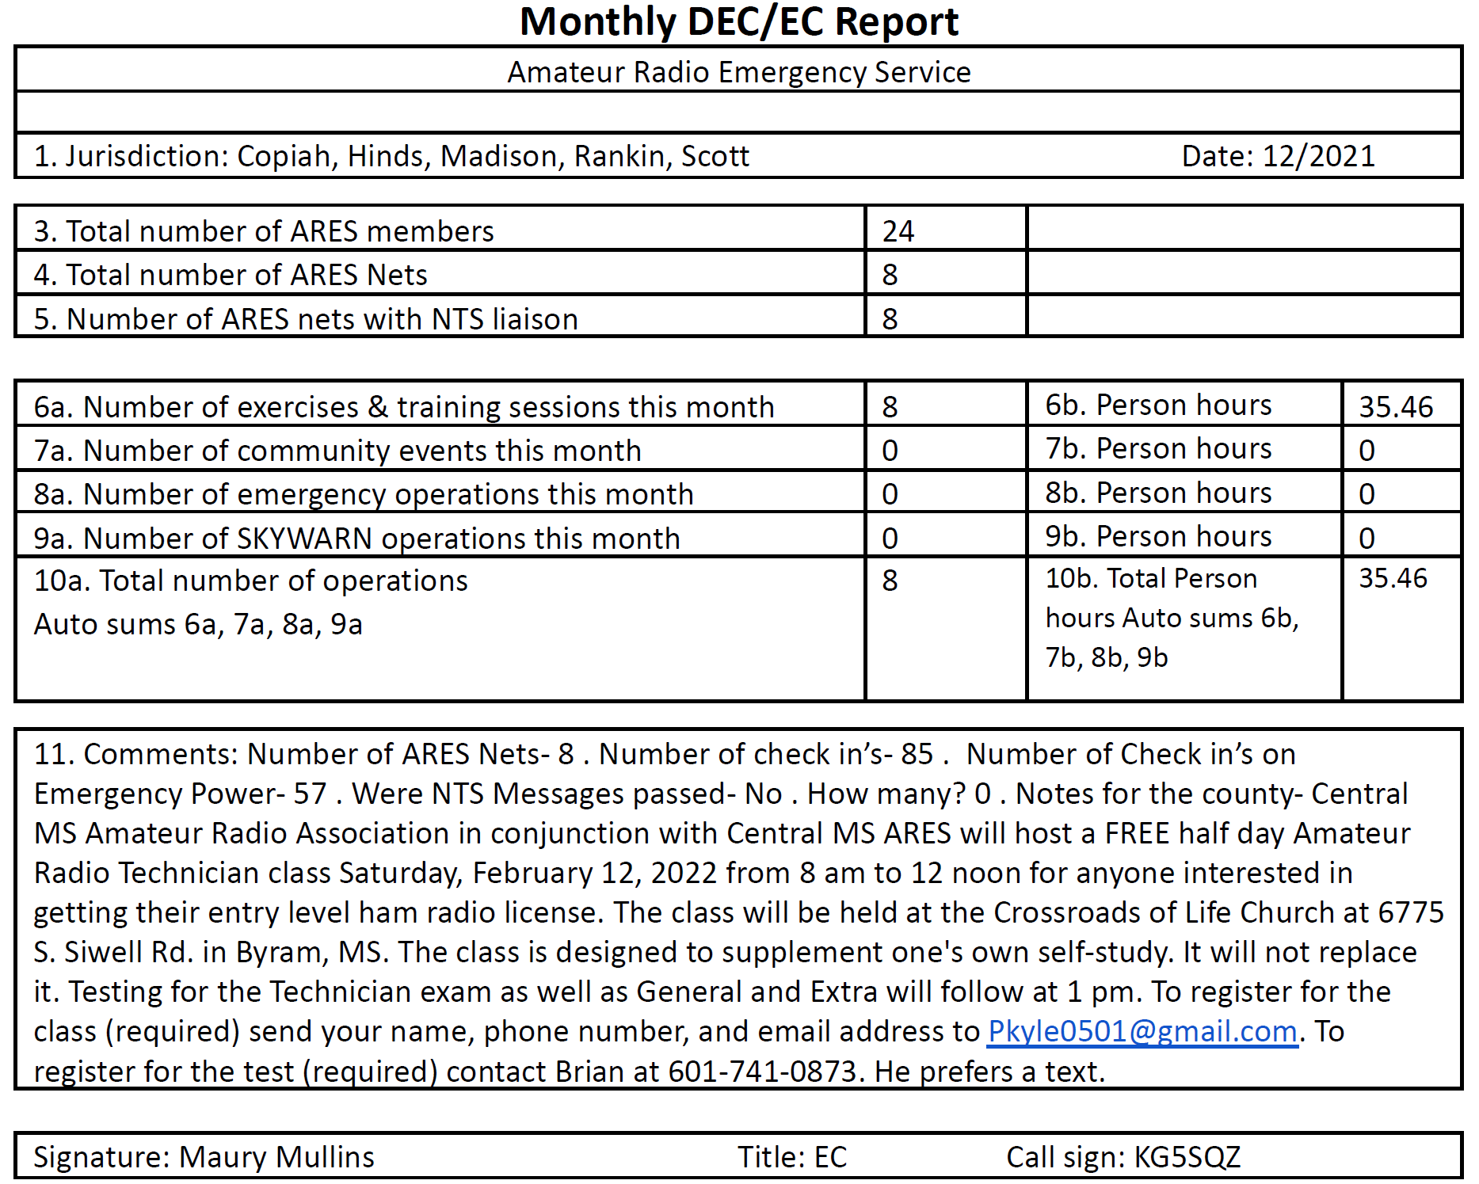
ARRL Form 2
These are the outputs from the web form submission.
These get created in Google Docs and then uploaded to Section Reports @ ARRL
These reports show the activity level and operations for a month’s period by reporting EC

Slide 13
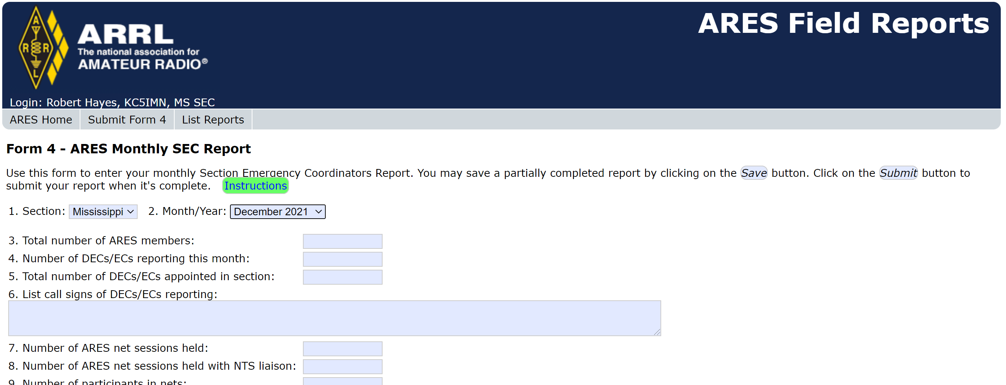
From Form 2 to From 4

Slide 14
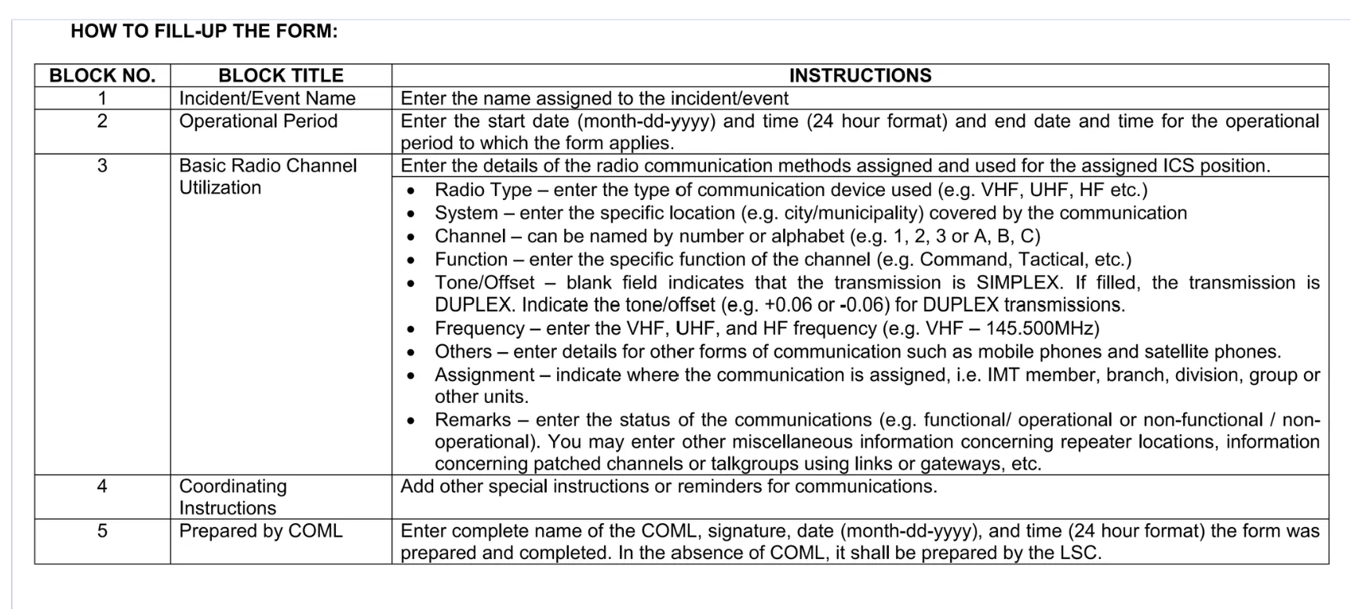
ISC-205 For Mississippi
The Incident Radio Communications Plan (ICS 205) provides information on all radio frequency or radio system talkgroup assignments for each operational period
The MS version is a living document, available online upon request.
The document is tabbed by district
Please take the time to review and report errors and updates

Slide 15
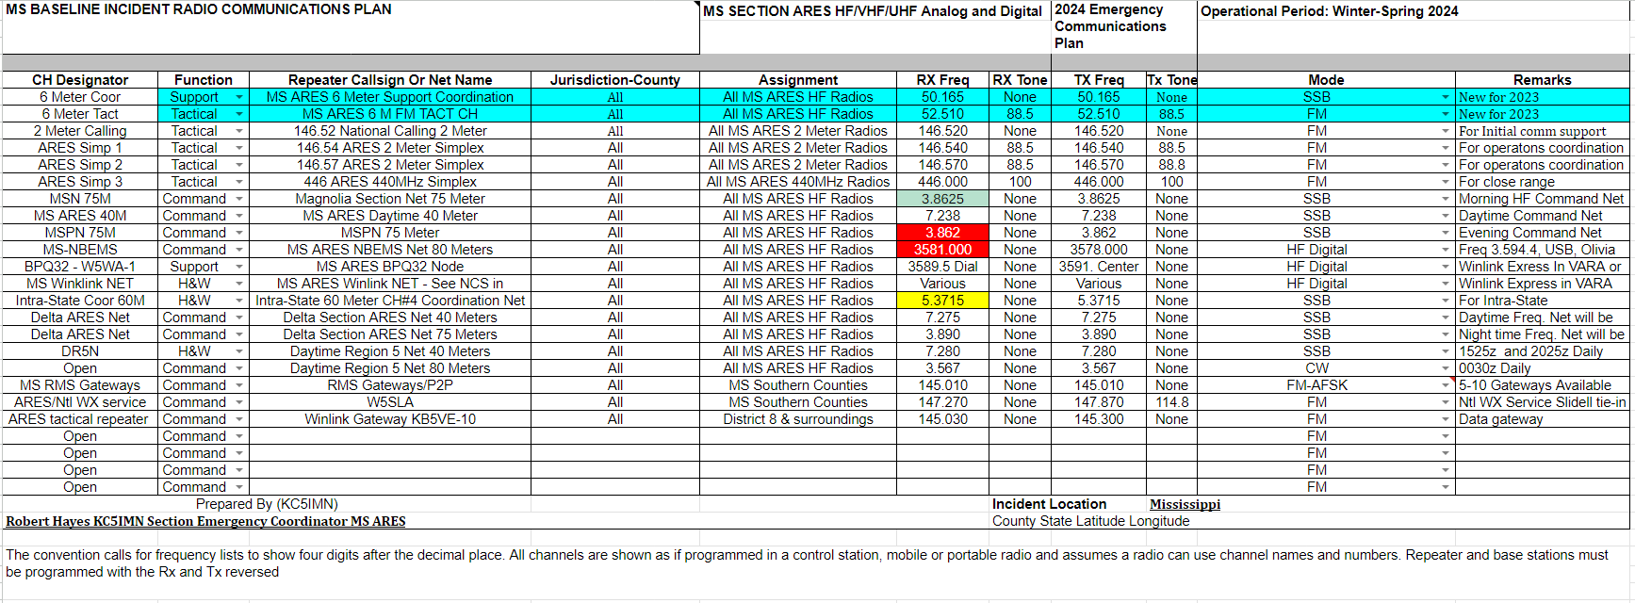
MS ICS-205 Online Resource

Slide 16
Enhancing Statewide Amateur Radio Emergency Services with VHF/UHF Analog Repeaters, DMR, and HF-NVIS
For 2025, the SET will be managed via all three services Analog Repeaters, Networked DMR (repeater and hot-spots), as well as HF-NVIS (3862 KHz SSB and 3581 KHz Digital Operations).
  We will need net control operators for DMR and HF-NVIS as these two services cover local, regional, and intrastate communications.
  ARES team members will use local Analog Repeaters to provide and receive tactical information to other ARES team members and served agencies.
Each district Emergency Coordinator shall establish processes to provide information to and from tactical scenes.
  It will be at the DEC’s discretion on which of the three services will be used to pass traffic.

Slide 17
EMPHASIS ITEMS SET 2025
ARES team members should be able to operate for 72 hours without resupply.
  Includes personal items and food
  Extra batteries, antennas, printed material
  Not totally dependent on mobile phones LTE or 5G services
  3862KHz LSB analog voice is still the primary statewide EMCOMM channel for ARES emergencies.
    Practice with and the ability to switch between NVIS 75, 60, 40 meter NVIS is highly encouraged (will your radio and antenna work on 60 meters?)
    VHF/UHF analog and digital (DMR) voice are secondary fail-over to bad NVIS propagation.

Slide 18
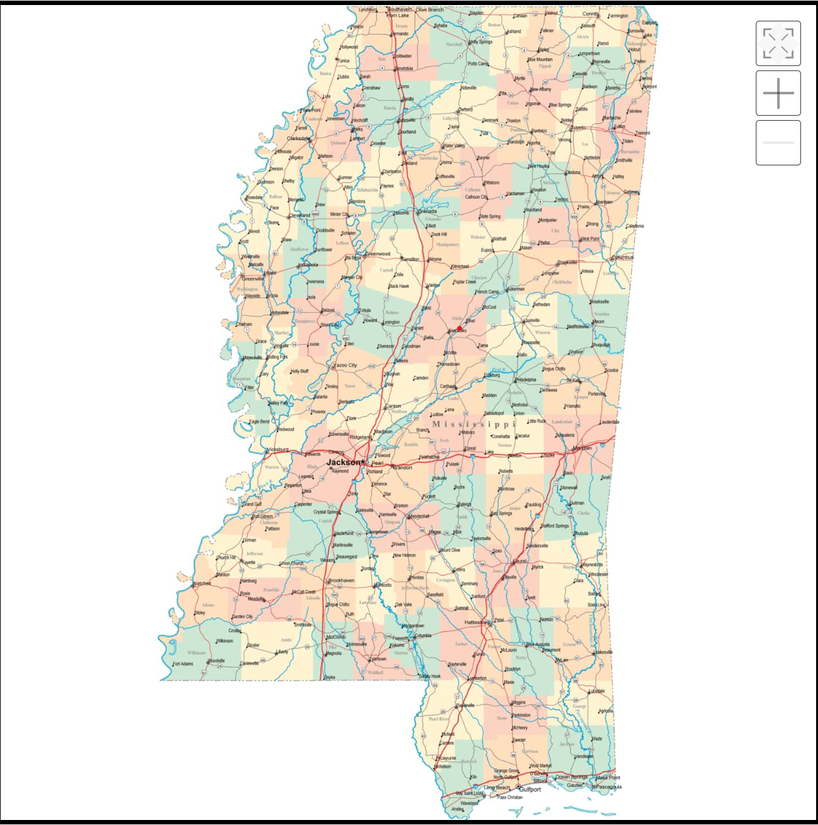



New ARES Districts Proposed for MS ARS
NORTH
NORTH CENTRAL
SOUTH CENTRAL
GULF COAST

Slide 19
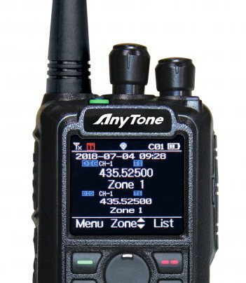
Contact Information:
Robert Hayes
KC5IMN
KC5IMN@arrl.net
903-244-9254

